Slide 1






in
HOPE ACTION
2023-24 UNITED WAY CAMPAIGN

Slide 2

Mission
United Way improves lives and community conditions in measurable, lasting ways.
Vision
A community where everyone can achieve their full potential.
GIVE
ADVOCATE
VOLUNTEER

Slide 3
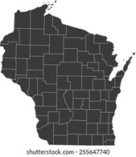


HOW UNITED WAY SUPPORTS SHEBOYGAN COUNTY
Community Support
Nonprofit Support
  Connect individuals and businesses to volunteer opportunities
  Provide advocacy and education on issues impacting our local community
  Community Needs Snapshot Project
  Resources and referrals through 2-1-1
  Lead and participate in community conversations to find long-lasting solutions to systemic issues
  Social Sector Diversity, Equity, Inclusion & Belonging Lead Organization
  Nonprofit Resource Network
  Supports volunteerism for local nonprofits
  Professional development & sector specific training opportunities
  Grants for local nonprofits (Small Grants, Emergency Reserve Grants, Day of Caring & Partner Agency funding)
Notes:
More than just fundraisers.
Most know us for our investments in local programs, which is one of our main products, but to fill our mission we must play a larger role in the community. We do this through Community Support (list) and Nonprofit Support (list).

Slide 4





NEEDS IN SHEBOYGAN COUNTY
Disaster <1%
Other 5%
30% OF HARDWORKING HOUSEHOLDS IN SHEBOYGAN COUNTY STRUGGLE TO PAY FOR BASIC ESSENTIALS LIKE:
Transportation Assistance 3%
Child Care & Parenting <1%
Gov't & Legal 5.1%
Clothing & Household 2%
Employment & Income 4.8%
Mental Health
& Addictions 16.5%
2022 TOP CALL CATEGORIES
(After Healthcare & COVID supports)
Healthcare & COVID-19 17.1%
Housing
Child Care
  Housing & Shelter
  Mental Health & Addictions
  Utilities
Utilities 14.9%
Food 7.1%
Mental Health
Gov’t & Legal
Housing & Shelter 23.9%
CALL 211 | TEXT your zipcode to 898211
OR VISIT 211wisconsin.org
Source: ALICE Report www.unitedforalice.org
Top Referrals by Category Above
Source: 211 Call Center wi.211counts.org/
Notes:
United Way of Wisconsin joins hundreds of other United Way's to measure the 'ALICE' population across the states. This population represents the households living paycheck to paycheck, one emergency away from needing support on basic needs.

Slide 5



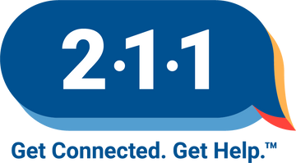


Help is 3 Numbers Away
211
Comprehensive database of community resources & provides information & referrals for essential needs like:
Call for
Information &
Community Resources
Support Groups
Food
Utility Assistance
Housing & Shelter
Disaster Aftercare
211
Healthcare Services
(including mental health resources)
Legal Services
Warm
Handoff
Warm
Handoff
911
Provides First
Responder
Dispatch For:
988
Provides Crisis Support For:
Whole
Person
Care
Medical
Emergency
Thoughts of
Suicide
Call for
Crisis Support &
Emotional Distress
Fire
Call for
Emergencies
Mental Health
Crisis
Warm
Handoff
Reporting A Crime
Substance Use
Crisis
Disaster Response
911
988
Any Life Threatening Situation
Emotional Distriss

Slide 6









2023-24 INVESTMENTS
LOCAL COMMUNITY IMPACT
EDUCATION
$606,927
HEALTH
$667,940
FINANCIAL STABILITY
$87,037
CRISIS & INITIAL ACCESS
$138,500
Community Partnership for Children (CPC)
Birth-to-6 initiative focused on parent supports, child development and kindergarten readiness.
Providing Access To Healing
(PATH)
Youth mental health initiative
increasing access to mental
health services.
Catholic Charities
Outreach/Case Management Services
Family Connections
Connections
Family Service Association
Budget & Credit Counseling
Financial Literacy
Lakeshore CAP
Rental Assistance
The Salvation Army
Comprehensive Services
American Red Cross of NE WI Chapter
Disaster Services
Boys & Girls Clubs of Sheboygan County
Summer Lunch Program
Lakeshore CAP
After Hours
Lakeshore Regional Child Advocacy Center
Forensic Interviews for Family
Mental Health America Lakeshore
Individual Assistance Program
Safe Harbor of Sheboygan County
Shelter & Helpline
Sheboygan County Food Bank
Supplemental Backpack program
Food Distribution
The Salvation Army
The Emergency Lodge
211 Call Center
Information and Assistance
Alzheimer's Association Southeastern WI
Awareness, Education & Support
Boys & Girls Clubs of
Sheboygan County
Healthy Lifestyles
CASA of East Central Wisconsin
Child Advocacy Support Services
Catholic Charities
Community Counseling
Family Connections
Rainbow Kids Youth Grief Support
Fresh Meals on Wheels of
Sheboygan County
Meals on Wheels Delivery
Mental Health America Lakeshore
Community Service/Advocacy
Partners for Community Development
Mental Health Translation Services
Safe Harbor of Sheboygan County
Youth Services
Sheboygan County Interfaith Organization
Bridgeway & Beyond TLP
Farmers Market
Family Pathways
The Salvation Army
The Red Shield Wellness Center
Bay-Lakes Council, Boy Scouts of America
Comprehensive Youth Development
Big Brothers Big Sisters WI Shoreline
Community Based Mentoring
School Based Mentoring
Boys & Girls Clubs of
Sheboygan County
Academic Excellence
Good Character
Family Connections
Child Care Resource Development
Family Resource Center of Sheboygan County
Parents as Teachers
Literacy Council Adult Tutoring
Foundations Health & Wholeness
RAYS
Girl Scouts of Manitou Council
Leadership Experience
Mental Health America Lakeshore
Education
Nourish Farms, Inc.
Farm to School
Farm to ECE
REINS, Inc.
Equine Assist Learning Program
Safe Harbor of Sheboygan County
Prevention & Education
$1.85M TOTAL INVESTMENT
NONPROFIT DEVELOPMENT & SUPPORT
$349,596
Volunteer Center of Sheboygan County
Supporting & coordinating volunteerism for individuals, nonprofits, and businesses.
SUPPORTING 44,013 PEOPLE IN SHEBOYGAN COUNTY
ALICE Report
Community Outreach & Awareness
Community Health Needs Assessment
Day of Caring Project Grants
Diversity, Equity, Inclusion
Emergency Grants
Nonprofit Resource Network
Professional Development
Small Grants

Slide 7



























PARTNERS
Notes:
United Way puts Hope In Action. Hope In Action for the kids that receive therapy; Hope In Action for families that receive food delivered to them; Hope In Action for transportation to a necessary doctor's appointment; Hope In Action to ensure that no one gets left behind.
We have a stake in creating a healthy, prosperous community. After all, we all win when a child succeeds in school, when a neighborhood is safe, when families have good health, and workers have solid jobs.
United Way connects people who want to make a difference in our community with the people who need help the most.
United Way is not a short-term investment; it’s about lasting change. We work to address our community’s most critical problems.
We address the complexity of people’s lives and communities by focusing on identifying root causes of issues and responding to immediate basic needs.
Giving to United Way’s Community Action Fund is an efficient and powerful way to invest in your community. It is also the best way for United Way to leverage donor dollars strategically and allows charities to make their dollars go further.
All donations to the Community Action Fund stay local and measured results are reported back to the community annually.
In addition to making financial investments in programs and community impact initiatives, United Way also helps increase the capacity and efficiency of our program partners through technical assistance and training, as well as connecting them to volunteers and other resources.
Change doesn’t happen alone. To live better, we must Live United.

Slide 8








IMPACT
67% of adults improved their financial standing
Catholic Charities, Consumer Credit Counseling, Family Connections, Family Resource Center, Lakeshore CAP, Sheboygan County Interfaith Organization, Salvation Army

Slide 9
IMPACT
57% of adults improved their overall health and wellness
Alzheimer’s Association Wisconsin Chapter, Catholic Charities, Family Resource Center, Meals on Wheels of Sheboygan County, Partners for Community Development, Safe Harbor of Sheboygan County, Sheboygan County Food Bank, Sheboygan County Interfaith Organization

Slide 10
IMPACT
88% of adults improved their mental health
Alzheimer’s Association Wisconsin Chapter, Catholic Charities, Mental Health America Lakeshore, Partners for Community Development, Safe Harbor of Sheboygan County, Sheboygan County Interfaith Organization, Salvation Army

Slide 11


OUR PROMISE TO YOU
UWSC continues to put your dollars to work in the community.
UWSC is committed to:
  Partner with local organizations, government and businesses to understand and solve complex issues
  Provide funding to nonprofit programs that have measured results with strong and sustainable financial health to help your dollars go further
  Strengthen the local social sector through providing the Nonprofit Resource Network, Volunteer Center Network, and educational trainings & workshops for nonprofit staff, boards, and the community
  Being community-owned and data-driven, providing accountability and transparency in all we do
HOPE IN ACTION

Slide 12
IMPACT
45% of youth (K-12) involved in community connectedness programs gave back through volunteerism to improve community conditions
Boy Scouts, Girl Scouts, Big Brothers Big Sisters, Foundations Health and Wholeness, REINS, Boys & Girls Clubs, Mental Health America, Safe Harbor, Nourish, and Rainbow Kids

Slide 13
IMPACT
78% of youth (K-12) improved overall health
and wellness
Big Brothers Big Sisters WI Shoreline, Boys and Girls Clubs of Sheboygan County, Foundations Health and Wholeness, Lakeshore Regional Child Advocacy Center, Nourish, Safe Harbor of Sheboygan County, Sheboygan County Food Bank

Slide 14
IMPACT
79% of youth (K-12) improved their
mental health
Boys and Girls Clubs of Sheboygan County, CASA of East Central Wisconsin, Foundations Health and Wholeness, Lakeshore Regional Child Advocacy Center, Mental Health America Lakeshore, PATH (Providing Access to Healing), Rainbow Kids, Reins, Inc., Safe Harbor of Sheboygan County, Sheboygan County Food Bank, Sheboygan County Interfaith Organization

Slide 15
IMPACT
68% youth (K-12) maintained or improved school performance
Big Brothers Big Sisters WI Shoreline, Boys and Girls Clubs of Sheboygan County, CASA of East Central Wisconsin, Mental Health America Lakeshore, PATH (Providing Access to Healing), Sheboygan County Food Bank

Slide 16
IMPACT
66% of parents with children 0-6 increased confidence in their parenting abilities
Parents as Teachers, Family Connections, Parent Cafes, SCIO, CPC Developmental Screens, Welcome Baby

Slide 17
IMPACT
60% of children who received a developmental screening identified a concern & received early intervention services
Parents as Teachers, CPC Developmental Screens, Progressive Beginnings Screens PATH

Slide 18
IMPACT
66% of children 0-6 achieved developmental milestones
Parents as Teachers, CPC Developmental Screens, Progressive Beginnings Screens

Slide 19
Making a difference
More than 600 volunteers donated 2,895 volunteer hours to complete
39 projects on Day of Caring; and more than $10,000 in Day of Caring Mini Grants were awarded
Volunteer Center of Sheboygan County

Slide 20
Making a difference
44,013 lives were made better because of the great generosity of Sheboygan County

Slide 21
Making a difference
1,222 families received community support, resources and referrals following the
birth of a child before
leaving the hospital
Community Partnership for Children,
Family Connections, Aurora and St. Nicholas Hospitals

Slide 22
IMPACT
Making a difference
8,547 therapy sessions
were provided through
school-based
mental health services
Providing Access to Healing (PATH)

Slide 23
Making a difference
1,122 callers from Sheboygan County connected to 2-1-1 information and resource specialists to find resources
2,557 referrals to local resources were made
2-1-1

Slide 24
Making a difference
501 households were provided rental assistance to overcome barriers and gain secure housing
Lakeshore CAP

Slide 25
Making a difference
211 children were provided a complete forensic interview and did not have to endure multiple interviews following a
traumatic event
Lakeshore Regional Child Advocacy Center

Slide 26
Making a difference
3,701 children gained leadership and life skills
Boy Scouts, Girl Scouts, Boys and Girls Clubs of Sheboygan County

Slide 27
Making a difference
7,984 individuals received mental health services and education
Alzheimer’s Association, Catholic Charities, Lakeshore Regional Child Advocacy Center, Mental Health America, PATH, Salvation Army

Slide 28
Making a difference
87,112 meals delivered to the homebound
Fresh Meals On Wheels

Slide 29
Making a difference
4,972 people received financial support
Lakeshore CAP, Catholic Charities, Consumer Credit Counseling, Family Connections, Salvation Army

Slide 30
Making a difference
3,200 families received emergency food
every month
Sheboygan County Food Bank

Slide 31
Making a difference
28,666 nights of shelter provided
Safe Harbor, Salvation Army,
Sheboygan County Interfaith Organization

Slide 32
Making a difference
1,770 parents received parenting education and support
Community Partnership for Children,
Family Connections, Family Resource Center,
Sheboygan County Interfaith Organization

Slide 33
Making a difference
19,945 youth participated in programs to improve their futures
Boy Scouts, Girl Scouts, Big Brothers Big Sisters, Foundations Health and Wholeness, REINS, Boys & Girls Clubs, Mental Health America, Safe Harbor, Nourish, and Rainbow Kids

Slide 34



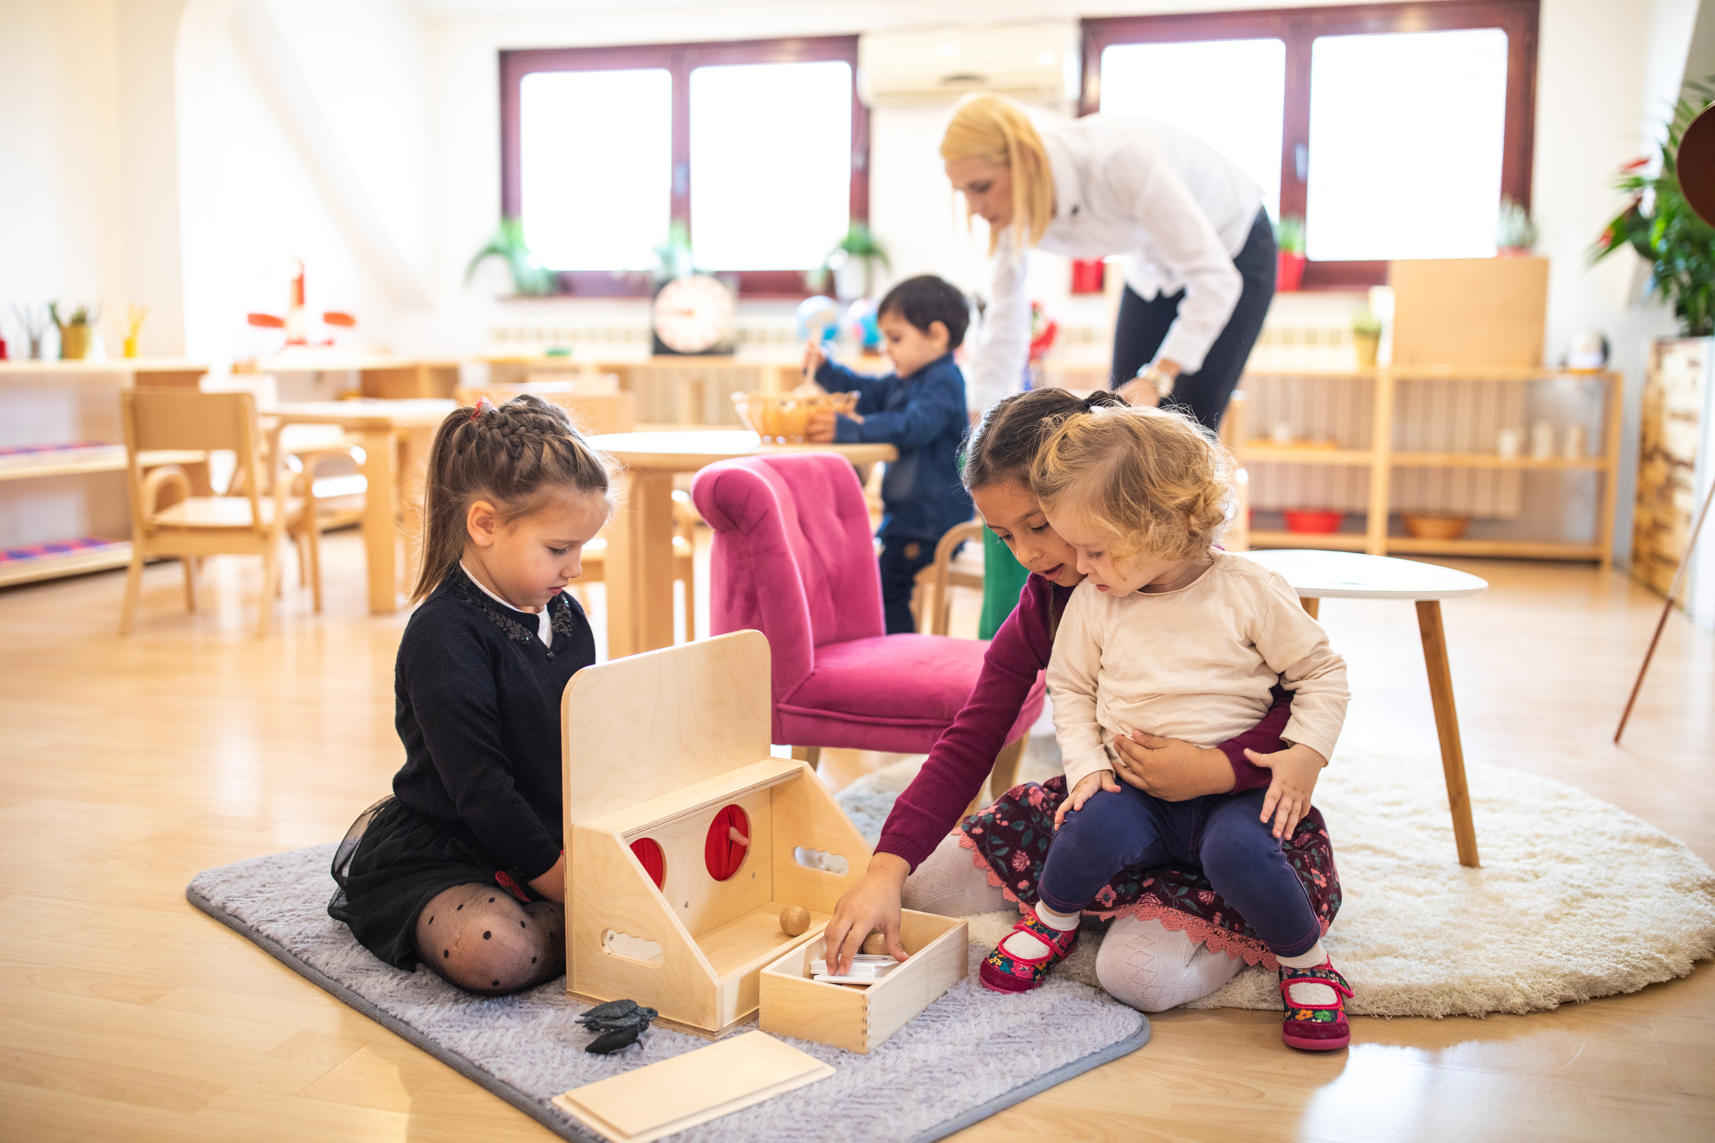


EVERY DOLLAR MATTERS
$25 GIFT
With one gift, you help more than 44,000 people in Sheboygan County.
United Way of Sheboygan County does what no single organization can do alone: Tackles the most pressing needs in our community by focusing on the building blocks of success; education, health, financial stability, and basic needs.
This change cannot happen alone. Our community needs YOU.
covers the application fee when applying to rent an apartment
$50 GIFT
provide food for a classroom of students during good food education
$100 GIFT
provide a family of four with childcare co-payments for one month
$250 GIFT
covers the cost of two (2) 1-hour budget and credit counseling sessions complete with an action plan, realistic budget, and follow-up
$500 GIFT
provides advocacy services for a child that has been found to be in need of protection and services for three months

Slide 35
in
HOPE ACTION
Looking for more ways to get involved?
Attend an upcoming event
Volunteer Year-round
Host a Donation Drive
Invite others to give with you Give to a Wish List
Donate
Join a Committee
uwofsc.org/getinvolved

Slide 36
in
HOPE ACTION
Connect with us!
CALL
EMAIL
VISIT
920-458-3425
info@uwofsc.org
uwofsc.org

